Slide 1

Connecting People and Home
——MIoT Platfrom introduction

Slide 2



MIOT platform
Connecting people & home
Notes:
小米IoT平台的使命是连接人与家，小米体系内所有的智能硬件都通过小米IoT平台实现智能互联。

Slide 3
The Largest IOT platform worldwide
Notes:
在所有能找到的友商公布数据中，小米IOT平台无论设备链接、设备日活均是全球最大。

Slide 4
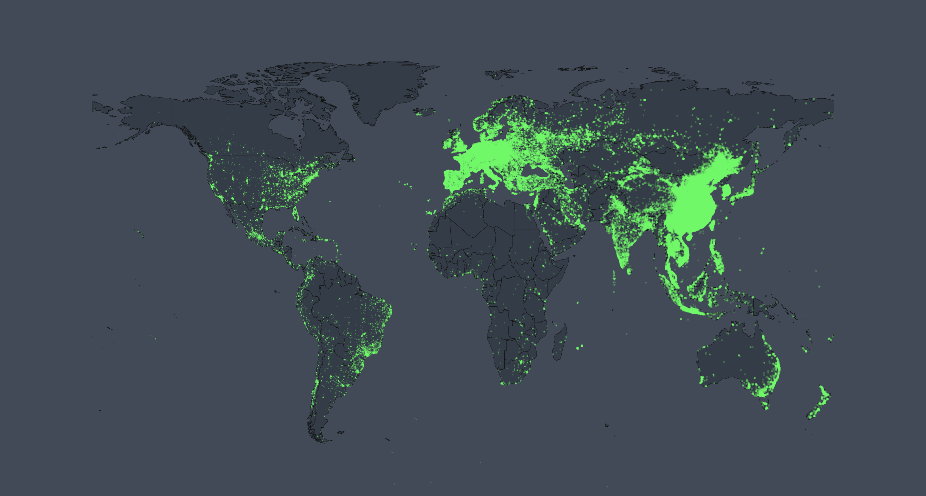
Connected devices in MIoT Platform
132 million
200+
Total number of connected smart hardwares
Countries and regions covered
Until 2018.09.30

Slide 5
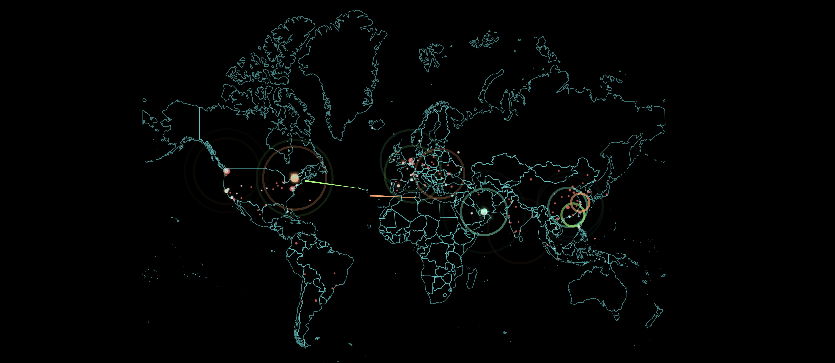
Daily active devices over
Active devices
Device Request per Day
20 Million
80 Billion
Until 2018.09.30
Notes:
不仅联网，而且活跃，这是一个非常重要的指标。

Slide 6
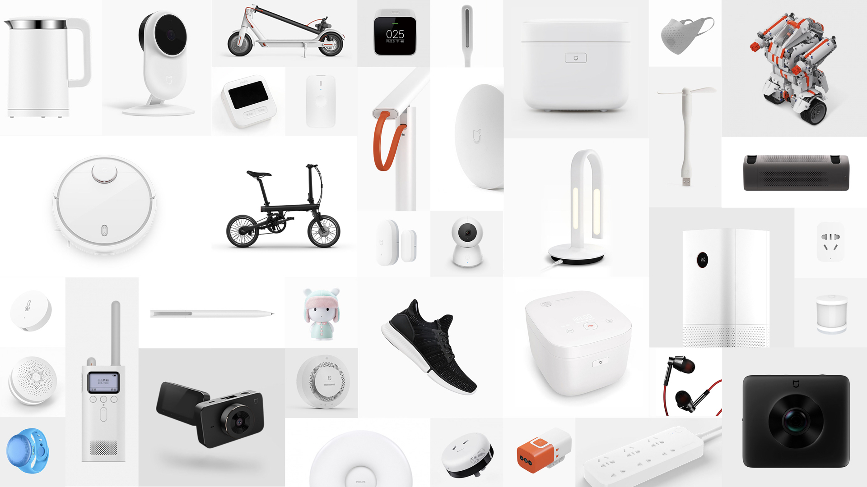

Notes:
The slide goes from few products to few
Ecosystem started in 2014, creating high quality, beautifully designed phone accessories such as powerbanks, earphones, etc.
Next IoT
Now also lifestyleproducts

Slide 7
MIOT Capability Introduction

Slide 8
Smart Phone & Smart Speaker Centric Smart devices
MIoT Platform Strategy

Slide 9
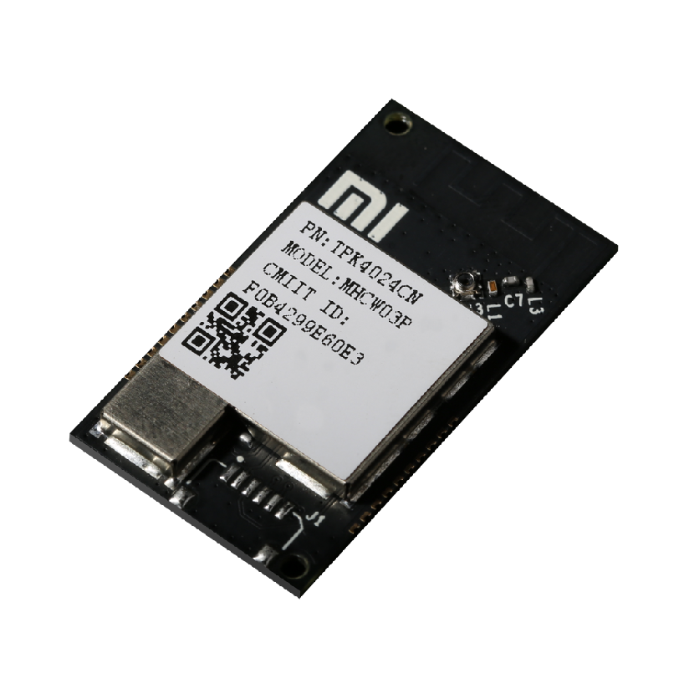
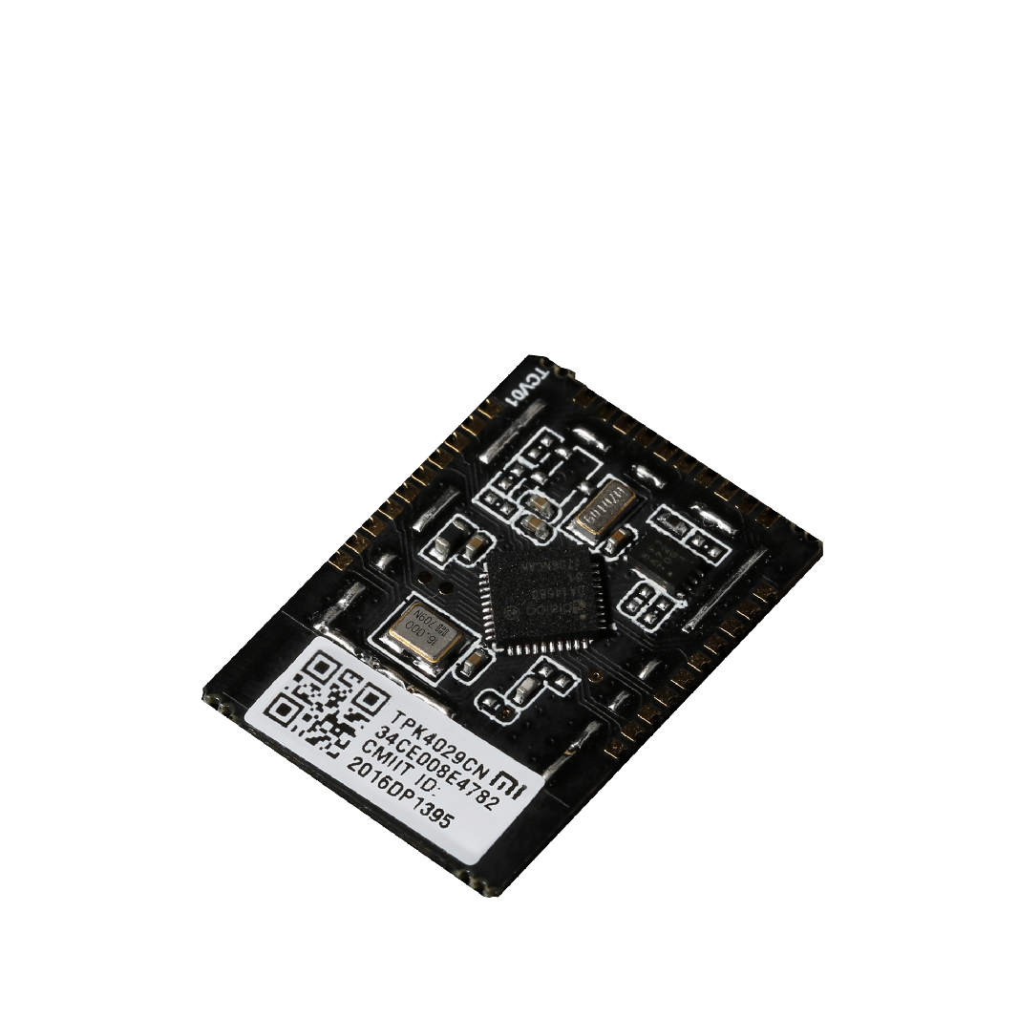
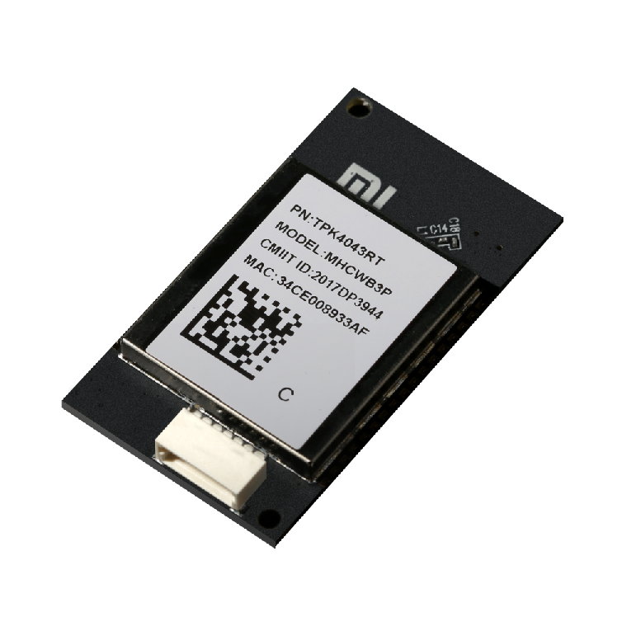
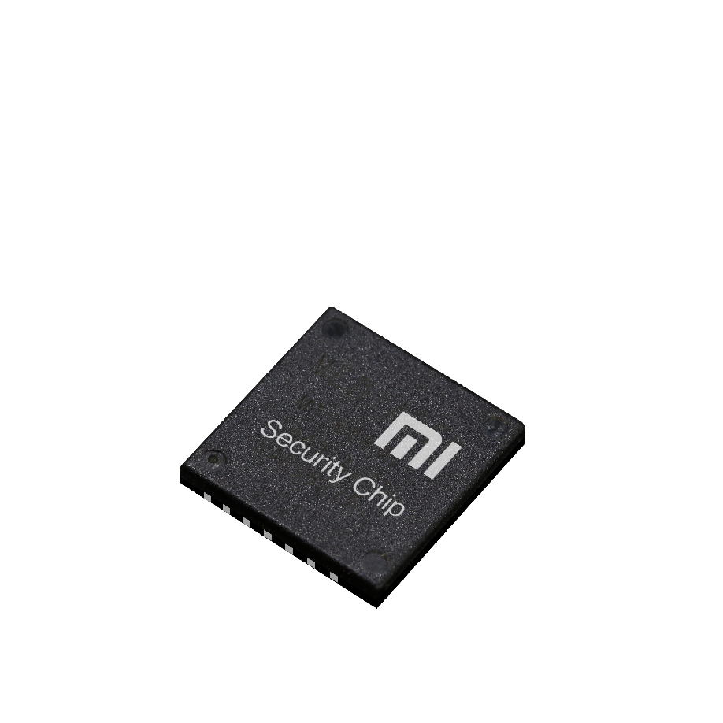
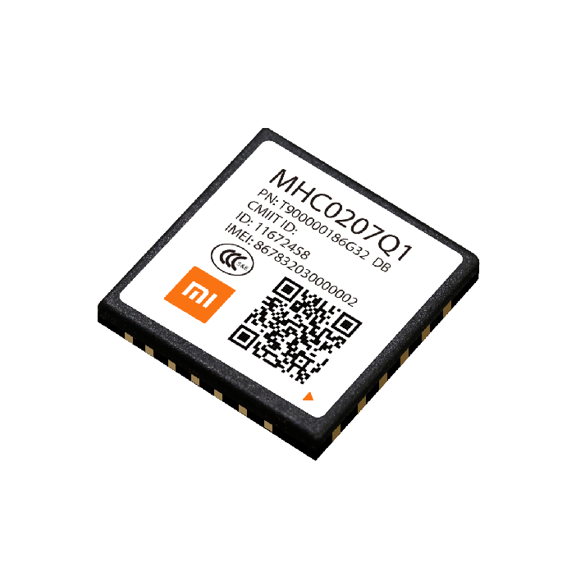
BLE Module
2015
WiFi Module
2014
WiFi+BLE dual-module
2016
Security Chipset
2017
NB-IoT Module
2018
Notes:
2014，研发WiFi模组，解决常带电设备的联网问题。
2015，研发蓝牙模组，解决可穿戴、传感器类功耗敏感设备的联网问题。
2016，研发WiFi+蓝牙4.0BLE双模模组，解决设备快速连接问题，并支持更好的蓝牙设备体验。
2017，研发硬件安全加密芯片，使用金融行业的加密级别，更好的保障锁类产品的安全。

Slide 10





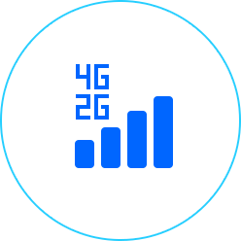


Various Connections for smart devices
Wi-Fi
RTOS
Standard Mi smart module
Bluetooth
Rich SDK/API
ZigBee
Android
MIoT standards
2-4G
Normative Hardware test & Certification
Linux
NB-IoT

Slide 11
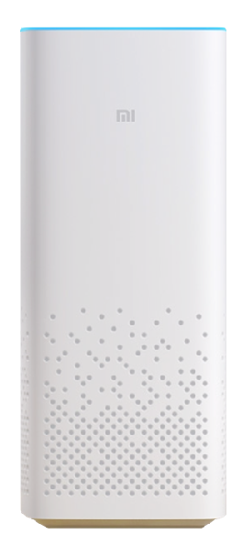
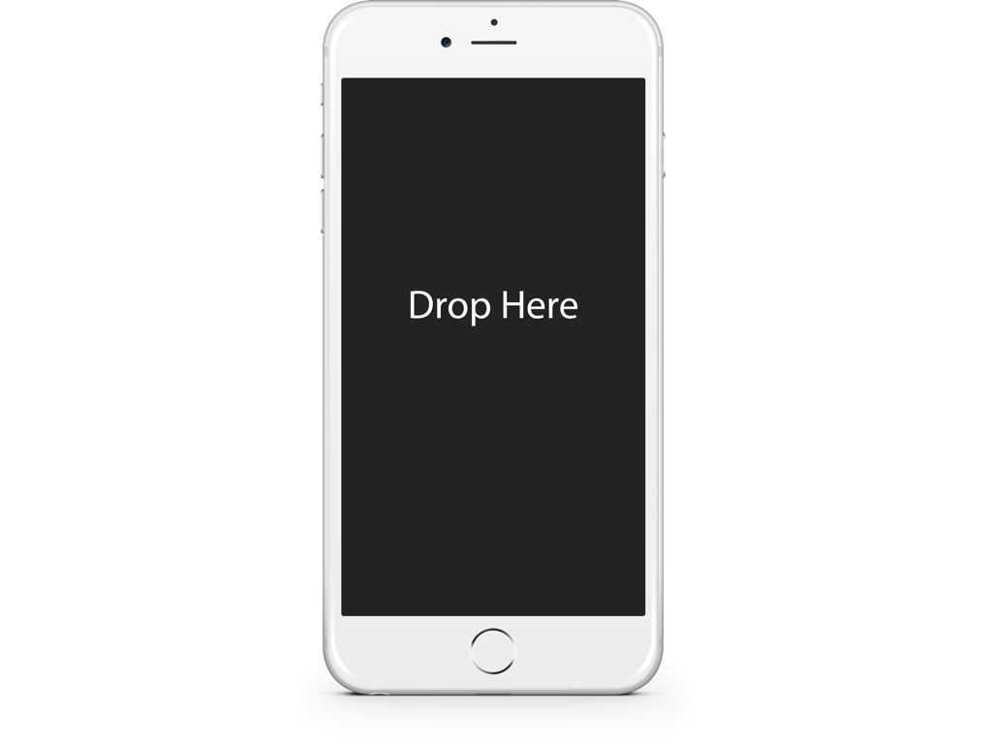

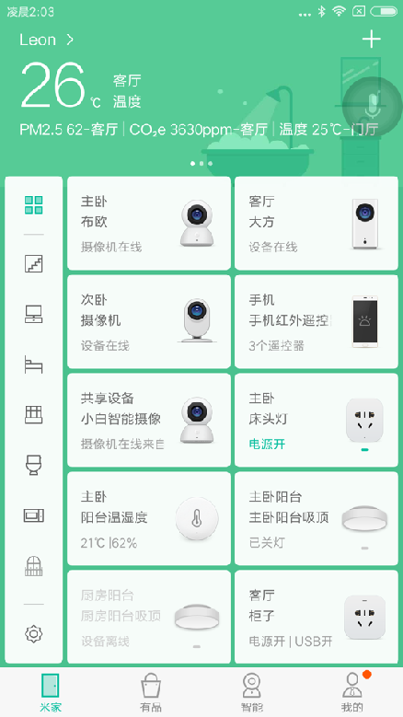
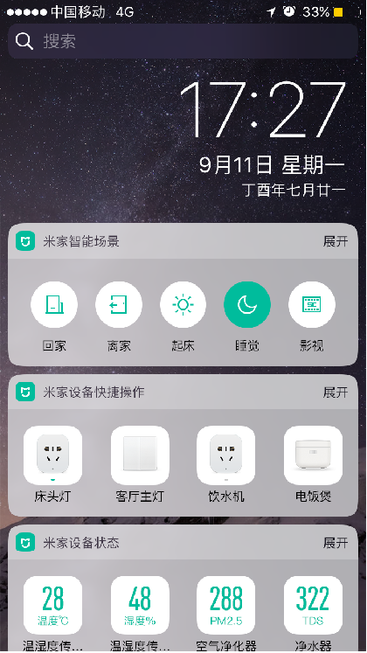
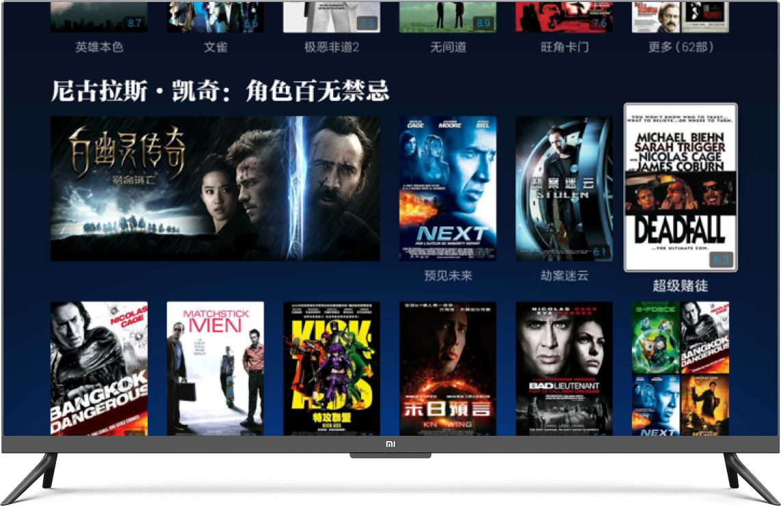
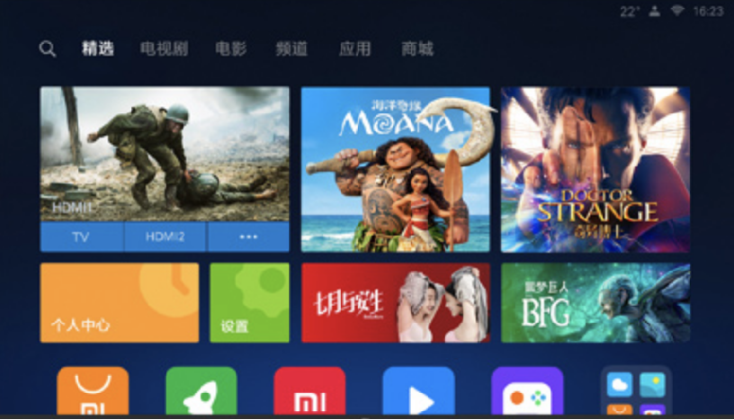

Multiple Access or Control of IOT device
Mi Speaker
WeChat mini-app
Mi Home APP
iOS Widget
TV
Developer SDK

Slide 12
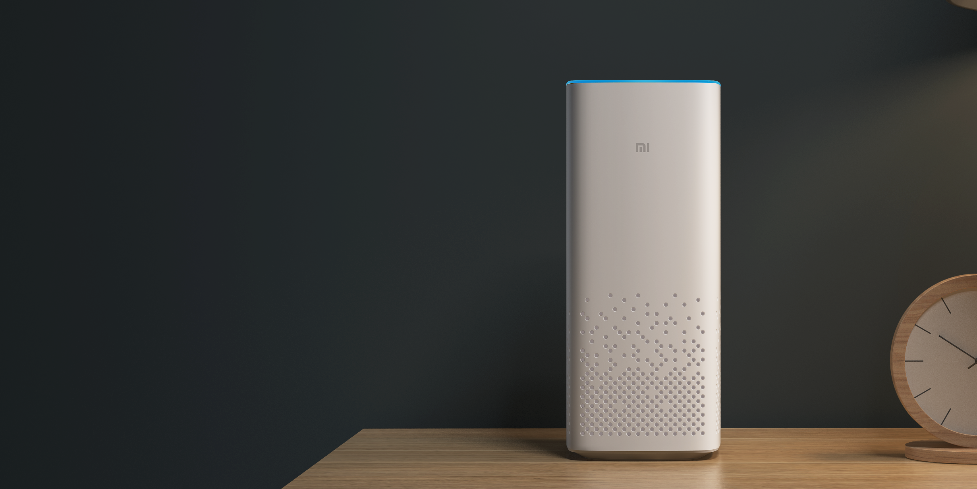
“Xiaoai tongxue” Smart voice control
Device Status Query
Device Control
Trigger joint Scenarios
Continuous Update

Slide 13
Video

Slide 14


Slide 15

One Word, Done!
Xiaoaitongxue，good night（trigger night mode）
xiaoaitongxue，switch on the bedroom light
xiaoaitongxue，what is air condition at home?
“xiaoaitongxue， ”
Xiaoaitongxue, get Cleanning Robot on work
Xiaoaitongxue, turn air conditioner to 25℃
Xiaoaitongxue, what is the temperture？

Slide 16

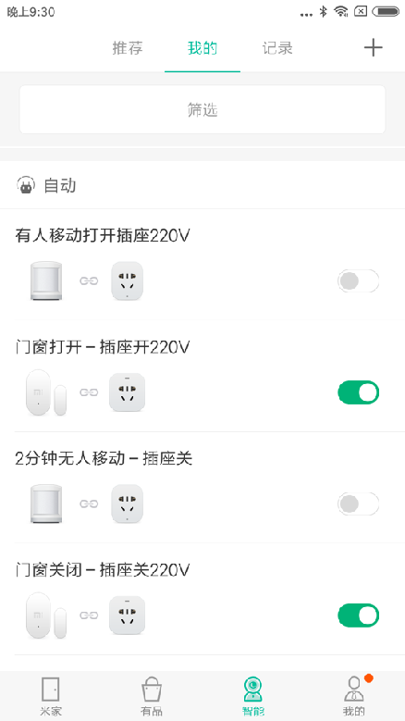
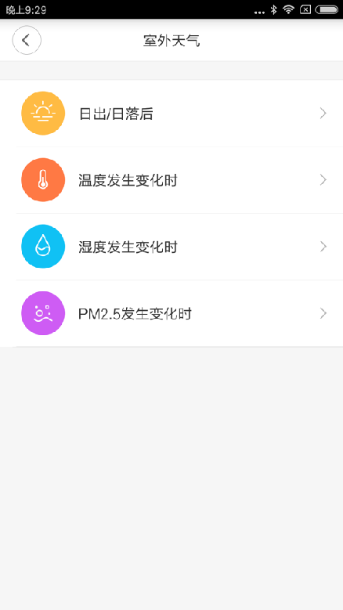
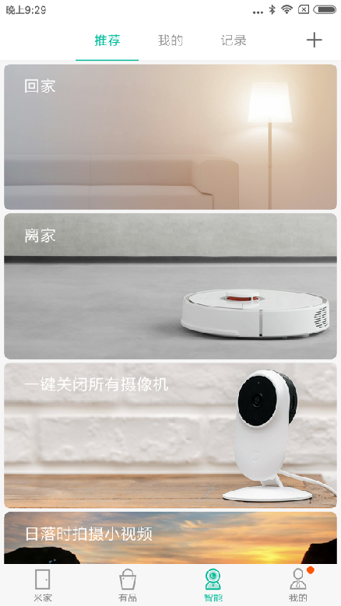
MIoT – Smart Scenes
After connecting to xiaomi devices，share the joint scenes with xiaomi devices
Self-defined joint operation
of devices
Multi-dimension life Scenes
Personallized smart
recommendation
Notes:
我们有足够多的用户基础和足够多的品类支撑，来实现智能设备之间场景互联的能力
举个例子

Slide 17
Rich Trigger Conditions
Human body Sensor
Voice Arouse
Light Sensor
Timing
GPS Range
Hygrothermograph
Door Lock
Door Magnetic
Wireless Switch
Water Sensor
Gas/Smog/PM2.5
Soil

Slide 18
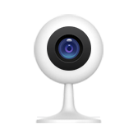


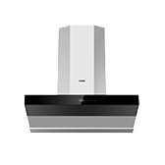
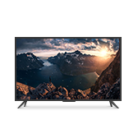


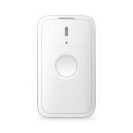



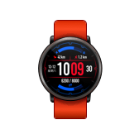


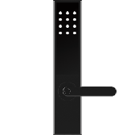
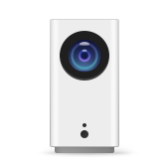
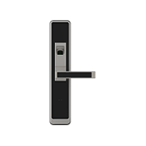

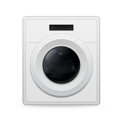
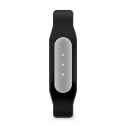
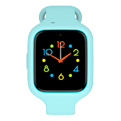
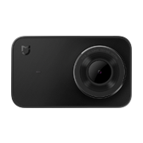

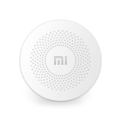




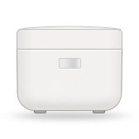
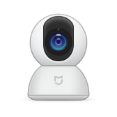


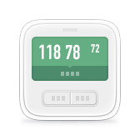

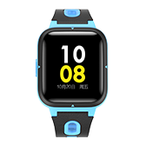
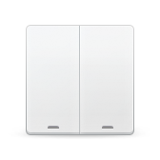



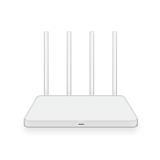





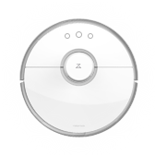

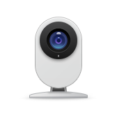


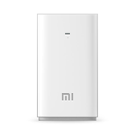



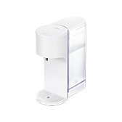
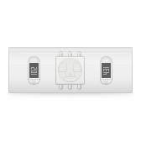
Based on our Massive Devices
User with 5 devices over
1.98 Million

Slide 19

BlueTooth Mesh

Slide 20



Traditional BlueTooth solution
BlueTooth
Internet
BLE device
Smart Phone
Cloud
Low power consumption、low cost、small size
Cannot always online
Require user to Launch App for data Sync, low activity
Cannot reach device timely，cannot acquire state and control
Notes:
我们对蓝牙设备又爱又恨，蓝牙方案本身有着低功耗、低成本、体积小等优势，很多可穿戴设备如手环、跑鞋，或无法用强电的设备如牙刷、温湿度计等产品，只能使用蓝牙。这类设备无法像WiFi设备一样长期在线，带来的问题就是需要用户主动通过手机APP来唤醒，导致这类设备整体活跃度大打折扣，久而久之甚至使其智能属性丧失意义。

Slide 21



BlueTooth Mesh
BLE + WiFi Dual-module
2016
BLE
Internet
BLE device
Cloud
Tens of dual-module product
Notes:
如今有了蓝牙Mesh，低功耗设备无需连接手机，通过用户家中的双模设备即可与云端进行通信。这个过程是全自动的，不需要额外的开发，只需要用户家中有双模的设备即可。目前米家平台中支持蓝牙Mesh的网关设备（即双模设备）已经多达十几款，且都是家中常见的必需品。

Slide 22
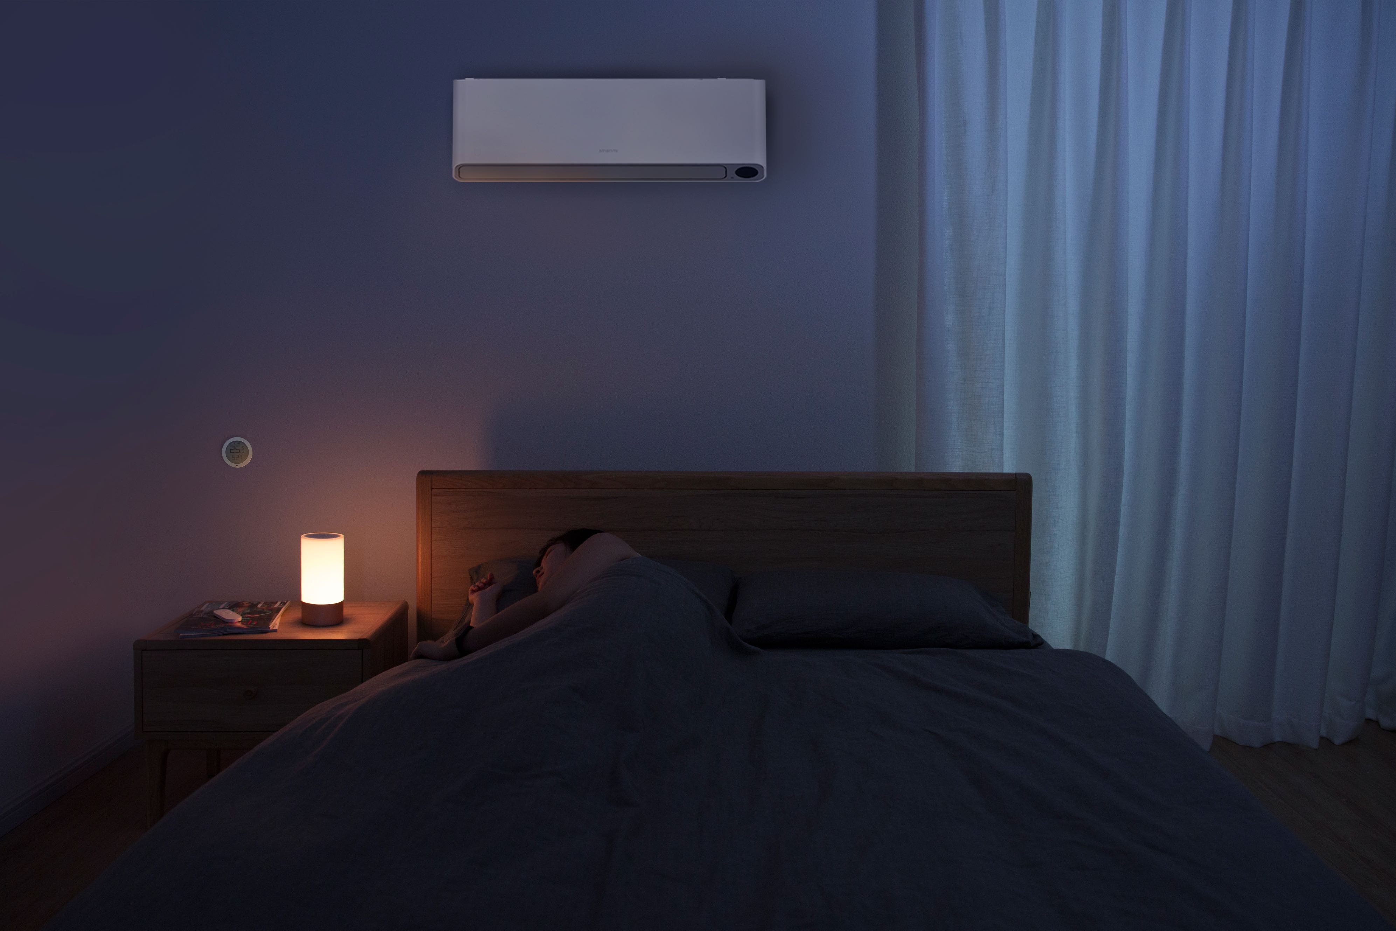



Mi Home BLE Hygrothermograph
Notes:
逻辑图，用线来描述关系。再次体现蓝牙网关

Slide 23

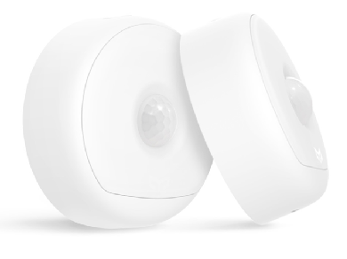
BlueTooth Mesh Scenarios
1、Low power consumption & remote control
2、Simple Data Synchronization
3、low cost to be smart

Slide 24
Continuously lower access barrier for smart device
Continuously Raise user experience for smart device
Notes:
小小的蓝牙网关，背后是小米IOT平台一致以来的愿景。
我们希望通过一个又一个的产品，不断的降低设备接入门槛、提升智能设备的体验
IOT蓝牙产品的体验革命

Slide 25




Whole Platform Capability is Open to Share
Open Access
Open Control
Smart Scenarios
Cloud+AI+Data
New Retail Channel

Slide 26





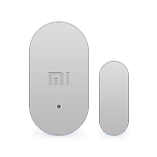
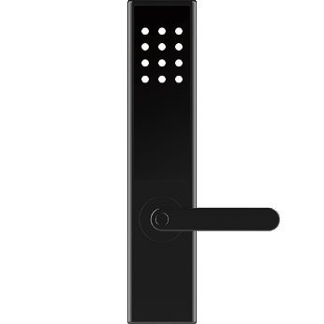

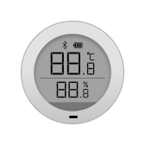




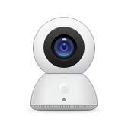
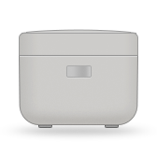






MIoT Architecture
Zigbee
BLE gatt
BLE beacon
2G/NB/4G
WiFi
BLE Mesh
…

Slide 27

MIOT Layered Model
Device
Cloud
Application Profiles
Application Profiles
Common services
Common services
Transport
Transport
Networking
Networking

Slide 28
MIOT Functional Model
Application Profile
Smart Home
Common services
Device Management
Device Operation
Security
Transport
TCP/UDP
Networking
IP
Device Management: Authentication, Log in, Keep alive, Time synchronization
Device Operation: Read, Write, Property Indication, Event Indication, Action
Security: TLS

Slide 29
Example Illustrating of MIoT Roles (without gateway)
APP
Cloud
Device
HTTP Request
OT/COAP Request
HTTP Response
OT/COAP Response
Note: OT is the application protocol defined in MIOT for common services

Slide 30
Example Illustrating of MIoT Roles (with gateway)
APP
Cloud
Gateway
Device
HTTP Request
OT Request
Zigbee/BLE Protocol
HTTP Response
OT Response
Zigbee/BLE Protocol

Slide 31

MIoT Resembles WOT deployment scenario 6
Legacy Device
Extension: Direct Cloud-Device link
WOT scenario 6 Servient on Cloud Server with extension of direct link between cloud and device

Slide 32
How to Work with other vendors
1. Cloud-to-Cloud interoperation
2. Module Level integration
3. SDK/Dual-protocol interconnect

Slide 33


1. Cloud-to-Cloud interoperation
User Authorization
Other Cloud
MIoT Cloud
Skill mapping
Mi Home APP / xiaoai tongxue
Other APP
Advantage：with any module，in-market device can directly inter-operate without hardware change, Cloud co-exist
Disadvantage：Complicate flow，bad user experience，long response time

Slide 34
2. Module Level integration
+
Voice control
Hardware D1
MI Module
MI Cloud
MI Home APP
Other APP
Data query
Advantage：Simple，low cost, Fast development，High Reliability
Disadvantage：In-market devices cannot access，Vendors cannot use their own cloud

Slide 35
3. SDK/Dual-protocol interconnect
MI Cloud
Other Cloud
MIoT protocol
Other IoT Protocol
Specific platform module
SDK with both protocols
Advantage：Cloud co-exist，simple flow
Disadvantage：In-market devices cannot access，require huge hardware development，has additional requirement for hardware

Slide 36
Thanks~

